Slide 1

Stack Overflow Developer Survey
Jan Paolo Valencia
02/17/2026

Slide 2



OUTLINE
Executive Summary
Introduction
Methodology
Results
Visualization – Charts
Dashboard
Discussion
Findings & Implications
Conclusion
Appendix

Slide 3

EXECUTIVE SUMMARY
Data contextualization and analysis goal
Methodology description
Data gathering
Data analysis
Data visualizations
Results presentation supported with graphs and trends
Discussion of overall findings and implications regarding the results previously exposed
Final conclusion of the carried out research

Slide 4

INTRODUCTION
Stack Overflow's annual Developer Survey is the largest and most comprehensive survey of people who code around the world.
Results does not represent everyone in the developer community.
Nearly 20,000 developers responded to the survey.
Trends to predict where the developers are going.
Characterization of developers around the globe.

Slide 5

METHODOLOGY
Collect survey data & explore its content
Data Wrangling
Exploratory data analysis
Data Visualization
Highlight distribution of data, relationships, the composition andcomparison of data.
Dashboards

Slide 6

Results

Slide 7
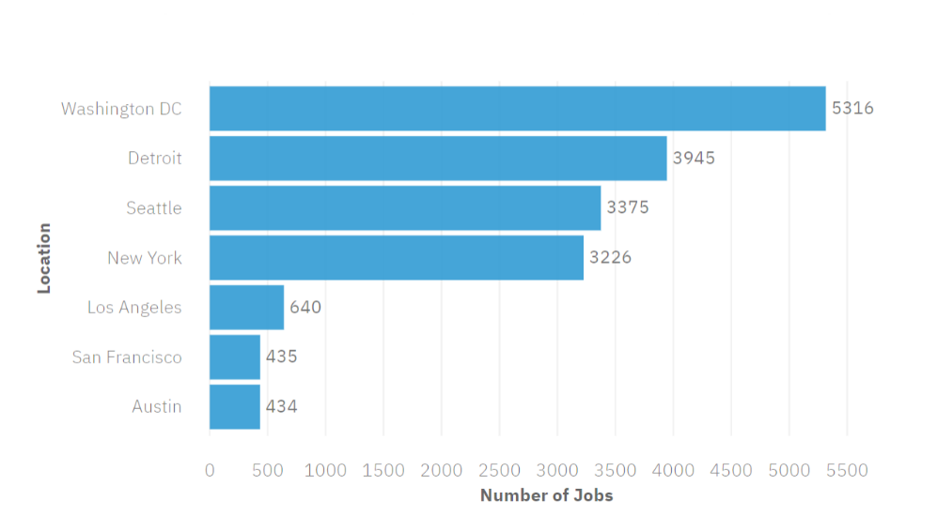
JOB POSTINGS

Slide 8
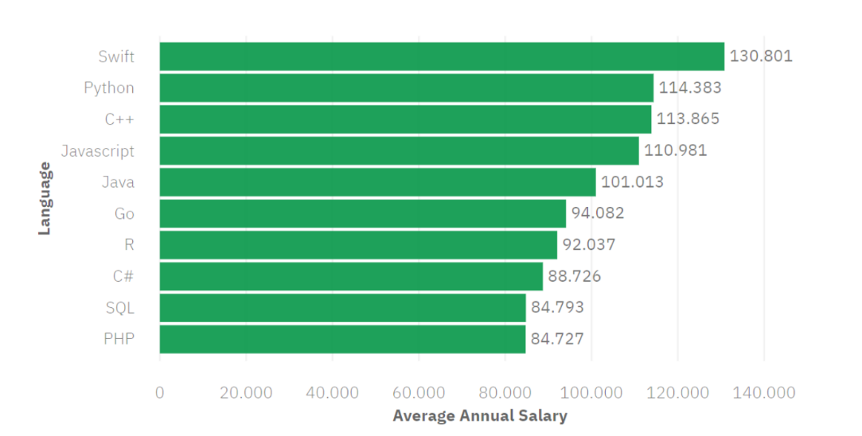
POPULAR LANGUAGES

Slide 9
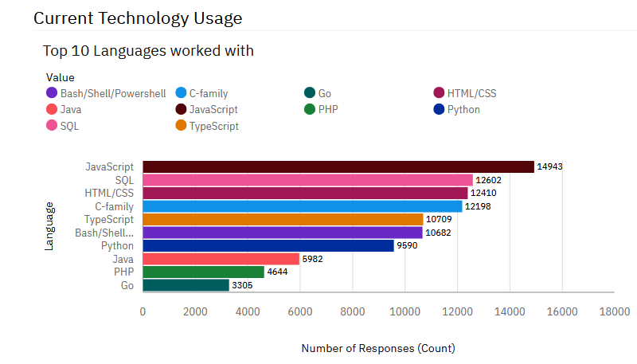
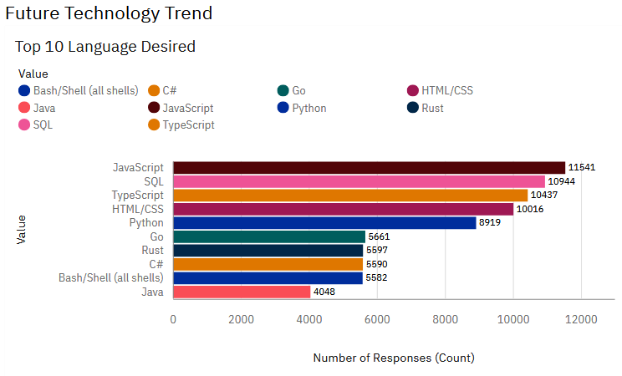
PROGRAMMING LANGUAGE TRENDS
Summarize key trends shown in the charts.
Current Year
Next Year

Slide 10
PROGRAMMING LANGUAGE TRENDS - FINDINGS & IMPLICATIONS
Findings
JavaScript remains dominant but declines in desire.
TypeScript and Go gain momentum.
Rust enters the top 10 desired list.
Implications
JavaScript is still essential but may face competition.
TypeScript’s rise reflects demand for safer, scalable web development.
Rust and Go represent future opportunities.

Slide 11
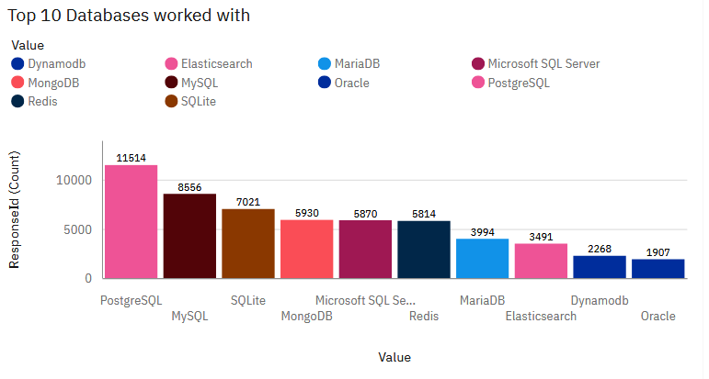
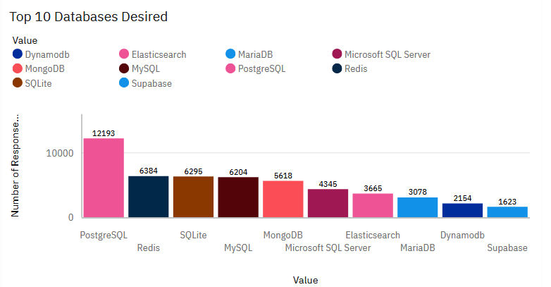
DATABASE TRENDS
Summarize key trends shown in the charts.
Current Year
Next Year

Slide 12
DATABASE TRENDS - FINDINGS & IMPLICATIONS
Findings
PostgreSQL leads both usage and desire.
Redis shows a strong “desire gap”.
Traditional enterprise databases lag in desire.
Implications
PostgreSQL is consolidating its dominance.
Redis is an emerging priority.
Shift away from legacy enterprise systems.

Slide 13

DASHBOARD

Slide 14
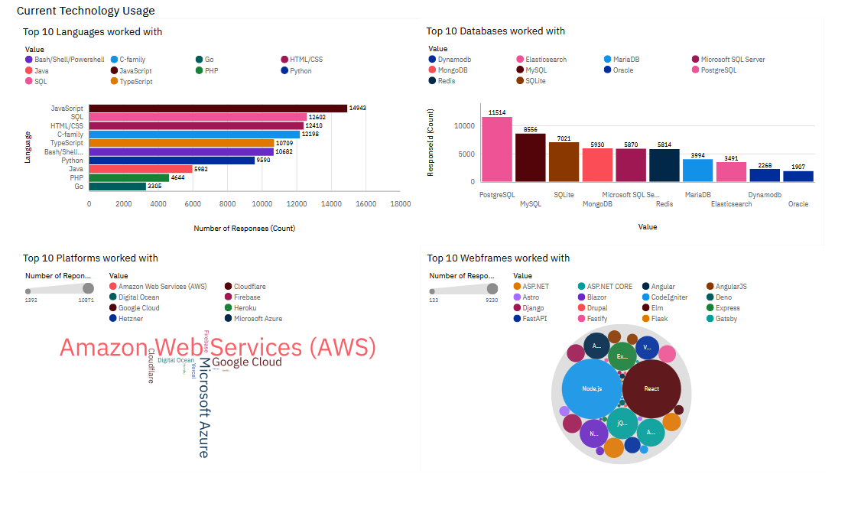
DASHBOARD TAB 1: Current Technology Usage

Slide 15
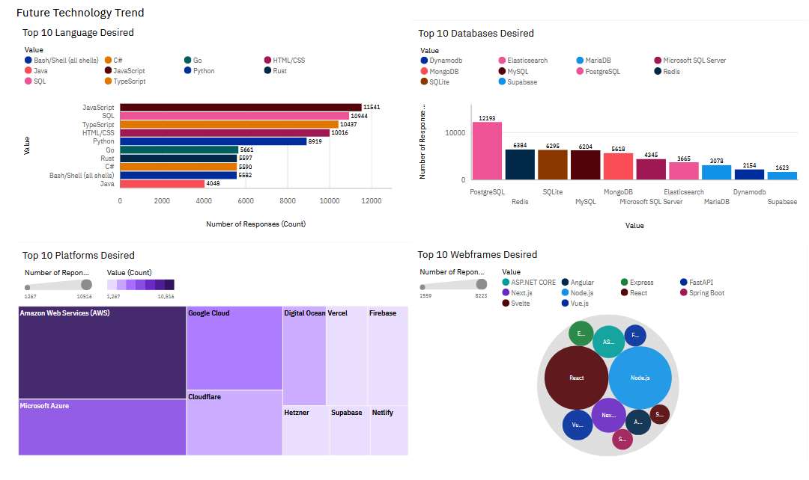
DASHBOARD TAB 2: Future Technology Trends

Slide 16
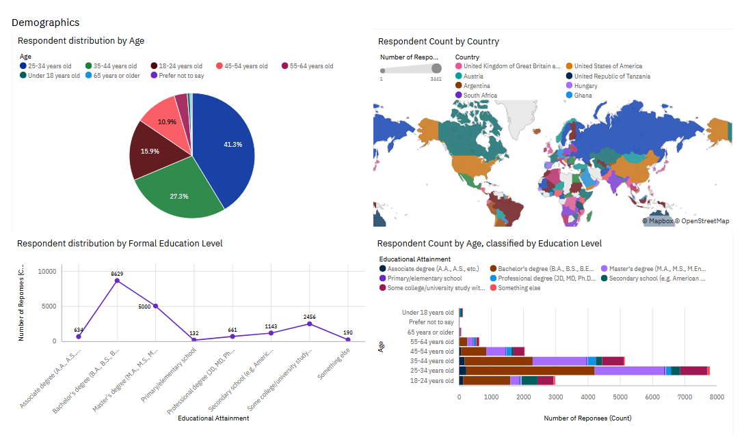
DASHBOARD TAB 3: Demographics

Slide 17
DISCUSSION
The dashboards highlight that developers continue to rely on core technologies such as JavaScript, SQL, React, AWS, and PostgreSQL, while showing strong future interest in emerging tools like TypeScript, Rust, Redis, Next.js, and modern cloud platforms. This reflects a clear industry transition: balancing established, widely adopted technologies with newer, performance-driven and developer-friendly solutions. Demographic data further shows a young, highly educated, globally distributed workforce, suggesting rapid adoption of modern tools and accelerating innovation across the industry.

Slide 18
OVERALL FINDINGS & IMPLICATIONS
Findings
Core technologies dominate: JavaScript, SQL, React, AWS, and PostgreSQL are the most widely used across developers.
Emerging tools gain traction: TypeScript, Rust, Redis, Next.js, and modern cloud platforms show strong future interest.
Developer demographics: The majority are young (25–34), highly educated, and globally distributed, with strong representation from the US and UK.
Implications
Balanced skill strategy: Developers should maintain proficiency in dominant technologies while investing in rising ones to stay competitive.
Industry transition: Organizations are shifting from legacy enterprise systems toward open-source, cloud-native, and developer-friendly ecosystems.
Innovation potential: A young, educated, global workforce will accelerate adoption of modern tools and drive rapid technological change.

Slide 19

CONCLUSION
Core technologies remain dominant — JavaScript, SQL, React, AWS, and PostgreSQL continue to be the backbone of development.
Emerging tools gain traction — TypeScript, Rust, Redis, Next.js, and modern cloud platforms show strong future interest.
Industry shift underway — Organizations are moving away from legacy enterprise systems toward open-source, cloud-native, and developer-friendly solutions.
Demographics drive innovation — A young, highly educated, globally distributed developer base accelerates adoption of modern tools and fuels rapid technological change.

Slide 20

APPENDIX
Include any relevant additional charts, or tables that you may have created during the analysis phase.

